Slide 1
welcome to Year 3

Slide 2
The year 3 team
Miss Budenis
Miss O’Connor (PPA)
Mrs Beasley (mon-weds)
Mrs Morter (weds-fri)
Mrs Cardelli (mon-weds)
Mrs Davies (Friday)
Mrs Nye (Friday)

Slide 3

Daily routine
8.40 door opens. Times tables practise/spellings/reading.
8.50 registration
9.00 maths/fluency
10.20 break
10.35 assembly
11.00 literacy and guided reading
12.30 lunch
13.30 afternoon lessons (2)
15.20 school day ends

Slide 4
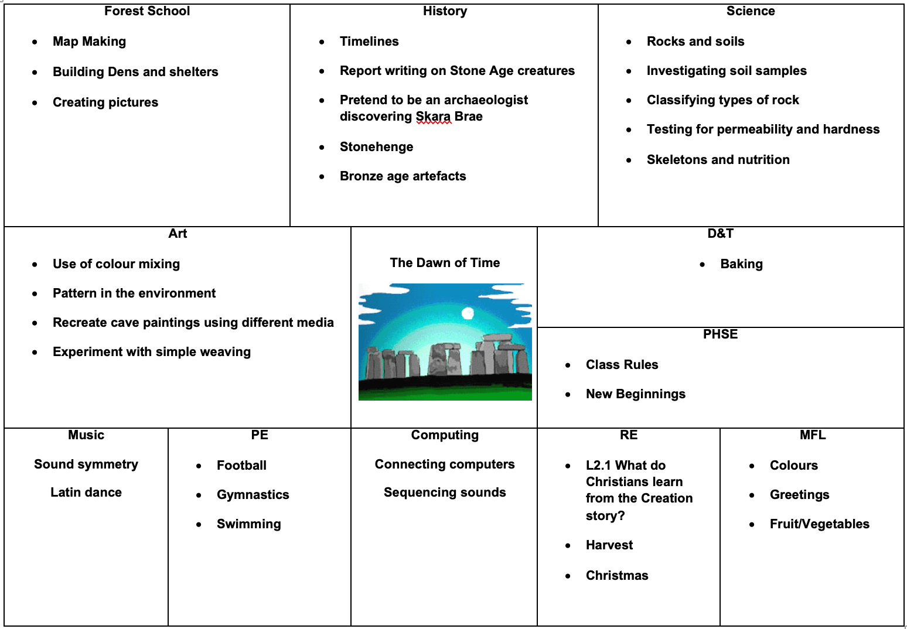
Change

Slide 5
Pe kits
Children need to wear their PE kits to school
Our PE lesson is on Monday/Tuesday
Please make sure children have their correct kit – weather appropriate
Swimming will start on Tuesday 23rd September

Slide 6
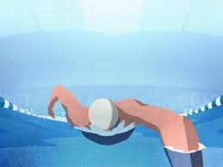
Swimming
Swimming will begin soon and will be each Tuesday
Swimming will take place at St Edward’s School
Children will need their own kit and goggles for each session

Slide 7

Forest school
Forest school will take place on a Thursday
Children need to have the right clothes
  Waterproof trousers
  Warm top
  Coat
  wellies

Slide 8
spellings
Children have brought home a spelling booklet with their spellings in
Tests will take place weekly on a Wednesday
Please assist your children in learning their spellings
Children need to learn their statutory spellings from their spelling fish. Any extra help with learning these words would be greatly appreciated.

Slide 9

reading
Children have access to a school library book
If they read at home with/to an adult for 15 minutes, sign the book mark
Our class text is ‘Stig of the Dump’

Slide 10

homework
Homework activities on website
Children should complete 2-3 tasks per half term from a list of activities and handed in when completed. This will be celebrated on a Friday afternoon
Spellings
Times tables
Reading
https://www.glenfall.gloucs.sch.uk/year-3/

Slide 11
Times tables
A real focus of our Maths
Will help across the curriculum
Times Tables Rock stars is a great website which all children have access to

Slide 12
Museum on the Park Stroud
Thursday 25th September

Slide 13
cbudenis@glenfall.gloucs.sch.uk
Please drop me an email with any questions

